Slide 1
Ummah.
Tuba S. Abbasi
Advisor: Dr. Smolinski
Notes:
My capstone project is called Ummah.
And my advisor for this project is Dr. Smolinski.

Slide 2
Terminology
Ummah
Muslim
Notes:
Some terminology before I continue

Slide 3
Terminology
Ummah
Muslim
⬅️
Notes:
Ummah is an arabic word which mean community.

Slide 4
Terminology
Ummah
Muslim
⬅️
Notes:
Muslim is a person who follows the religion, Islam

Slide 5
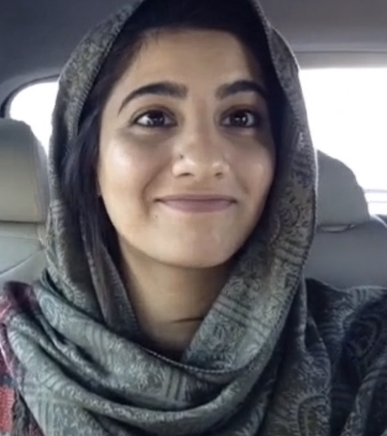
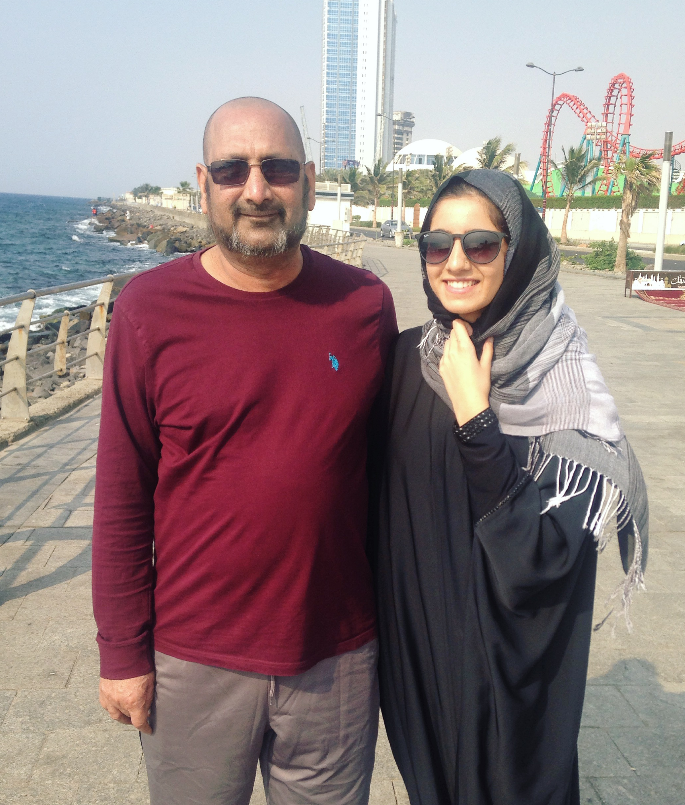
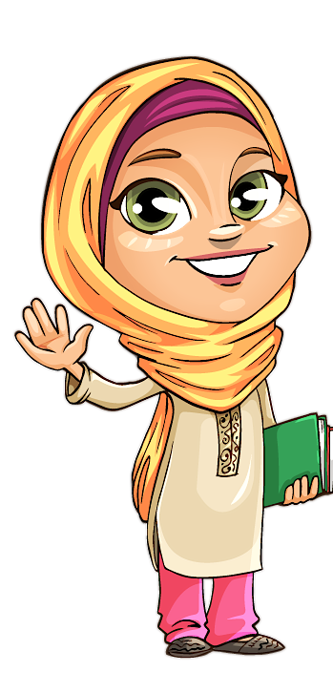
Motivation
Notes:
As an American Muslim, I am quite familiar with the challenges of practicing a Islam in a Non-Muslim majority country. I wanted to help my community overcome some of those challenges.
Let’s look at some of the issues that I seek to resolve…

Slide 6
Issue at Hand
Finding Mosques
Keeping up to-date on Mosque Events/Announcements
⬅️
Notes:
One big issue is with finding a Mosque in a Non-Muslim majority country.
For example…

Slide 7
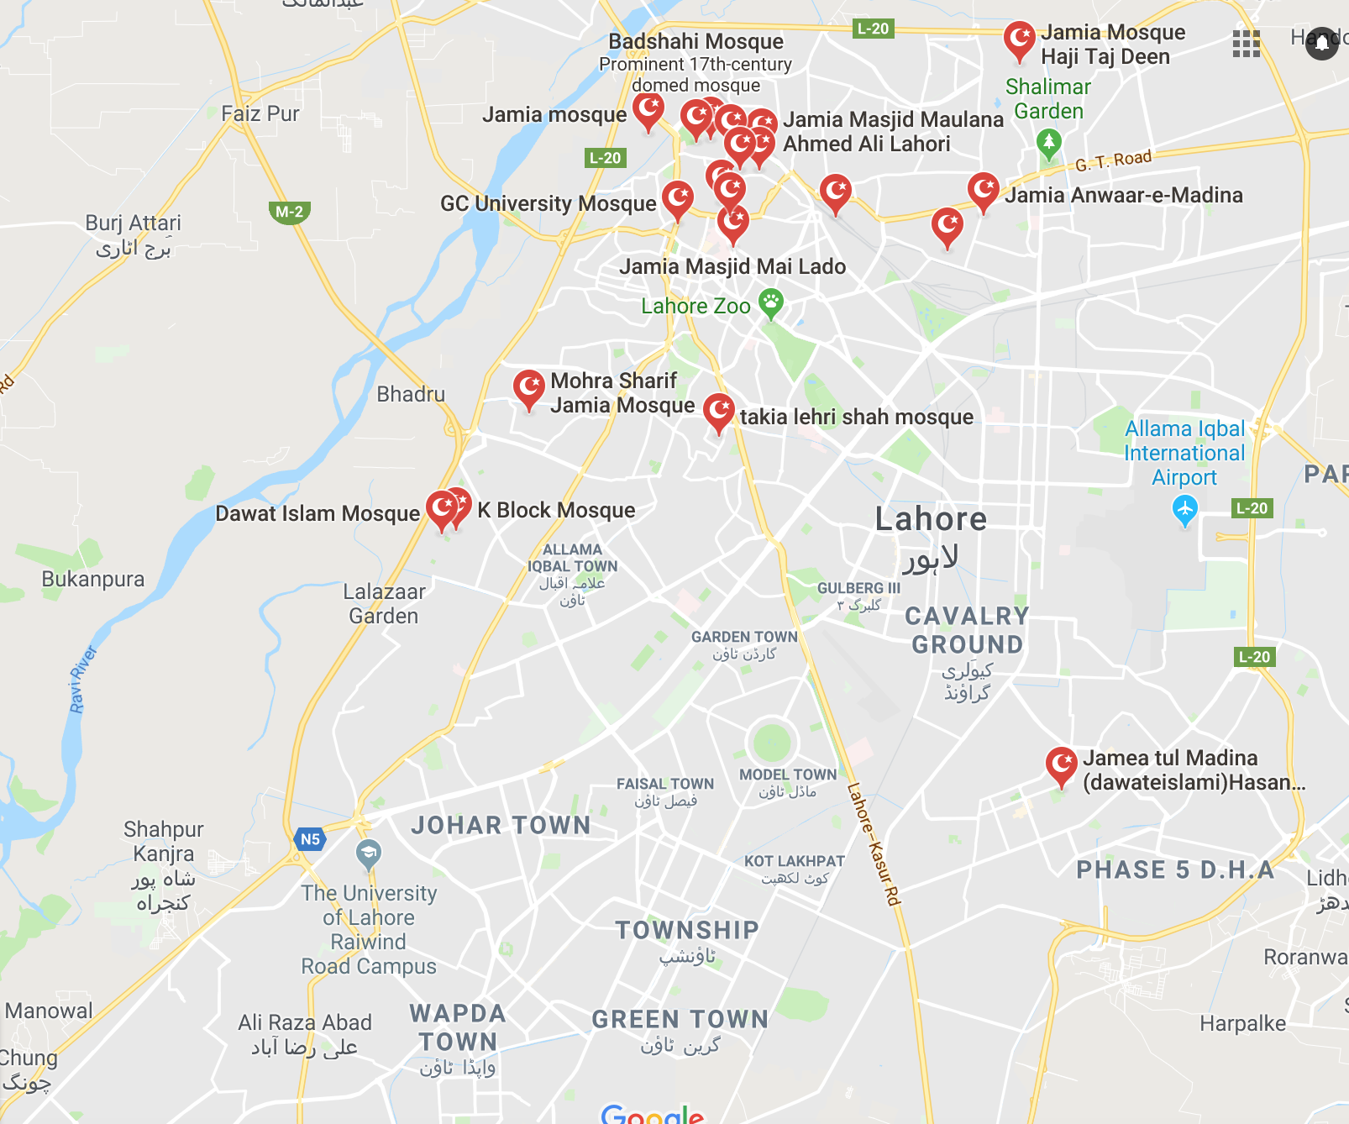
Mosque Search | LHR
Notes:
I did a search for Mosques in my hometown in Pakistan and got a decent number of hits within that area.
But when I do the same search in Delaware

Slide 8
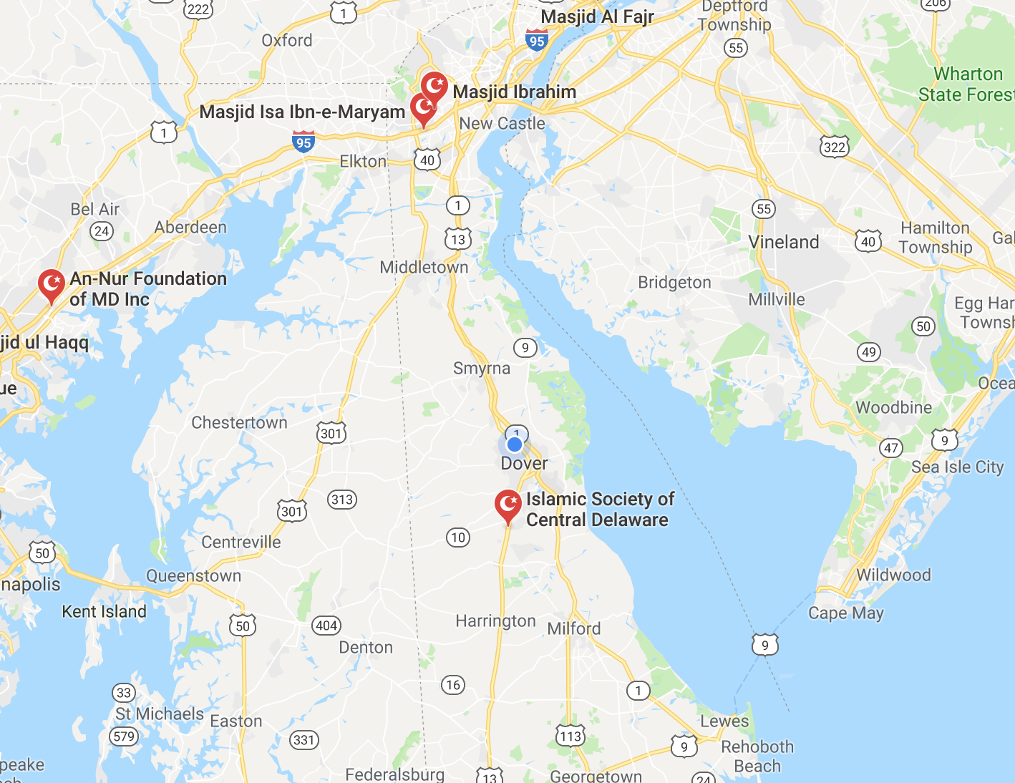
Mosque Search | DE
Notes:
I get this…. You can see the difference.
Picking a Mosque in a Muslim Majority country in no big deal since there is a Mosque in every other street.
But finding one here can be difficult.

Slide 9
Issue at Hand
Finding Mosques
Keeping up to-date on Mosque Events/Announcements
⬅️
Notes:
Another issue is that…
The existing apps for a lot of the Mosques are outdated, users are notified of an event either via email (instead of push notifications)
OR….sometimes they are not notified at all!
WHICH IS WHY

Slide 10


App for the Muslim Ummah
Notes:
I am developing a mobile app to help the Muslim community overcome some of those challenges.
Now I could sit here and say that the community needs this app, but the reality is that you can’t force what you think people need on them…..they have to believe it!
To confirm if there’s a need ….

Slide 11



💭
?
Notes:
I interviewed some people & sent out a survey to determine the usability of this app and understand my users.

Slide 12
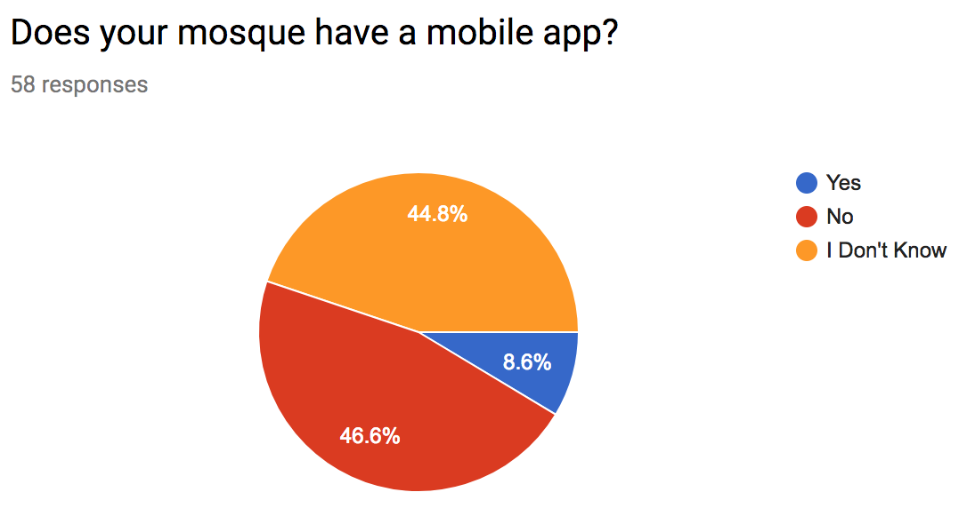
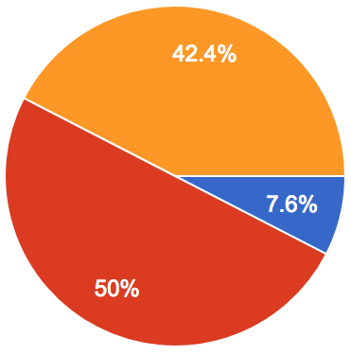
Does your mosque have a mobile app?
Notes:
From this chart you can see that half the people claimed that their mosque doesn’t have an app
and most of the remaining claimed that they’re not aware of it.

Slide 13
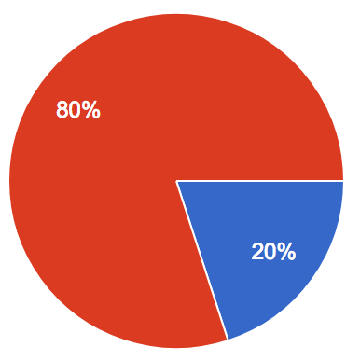
Do you use the mobile app?
Notes:
For one’s that did know about their mosques’ app, I asked them if they actually used it…. and 80% of them said no.
As I suspected, the biggest culprit for this was that these apps are too outdated

Slide 14
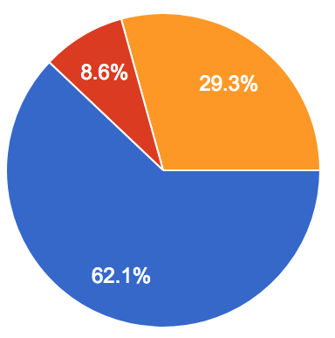
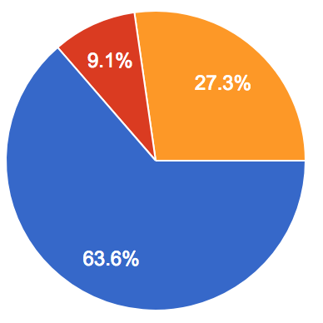
Would you use an app where you can subscribe to any mosque, and get updates about that mosque’s events, announcements, & prayer times?
Notes:
Lastly, I asked the community if they would use an app where they can subscribe to any mosque and get updates directly on their phone,
and you can see that majority of the people are open to an app like that.

Slide 15

Approach
Regular User
Mosque Owner
Notes:
My app will have 2 types of users.
NEXT

Slide 16
Approach
Regular User
Mosque Owner
⬅️
Notes:
First we have the regular users who will be using and interacting with the mobile application.

Slide 17
Approach
Regular User
Mosque Owner
⬅️
Notes:
Then you have the mosque owners who will claim themselves on my app via a web-based dashboard.

Slide 18
Use Cases
Notes:
Here are some ways both these users can utilize my app.

Slide 19
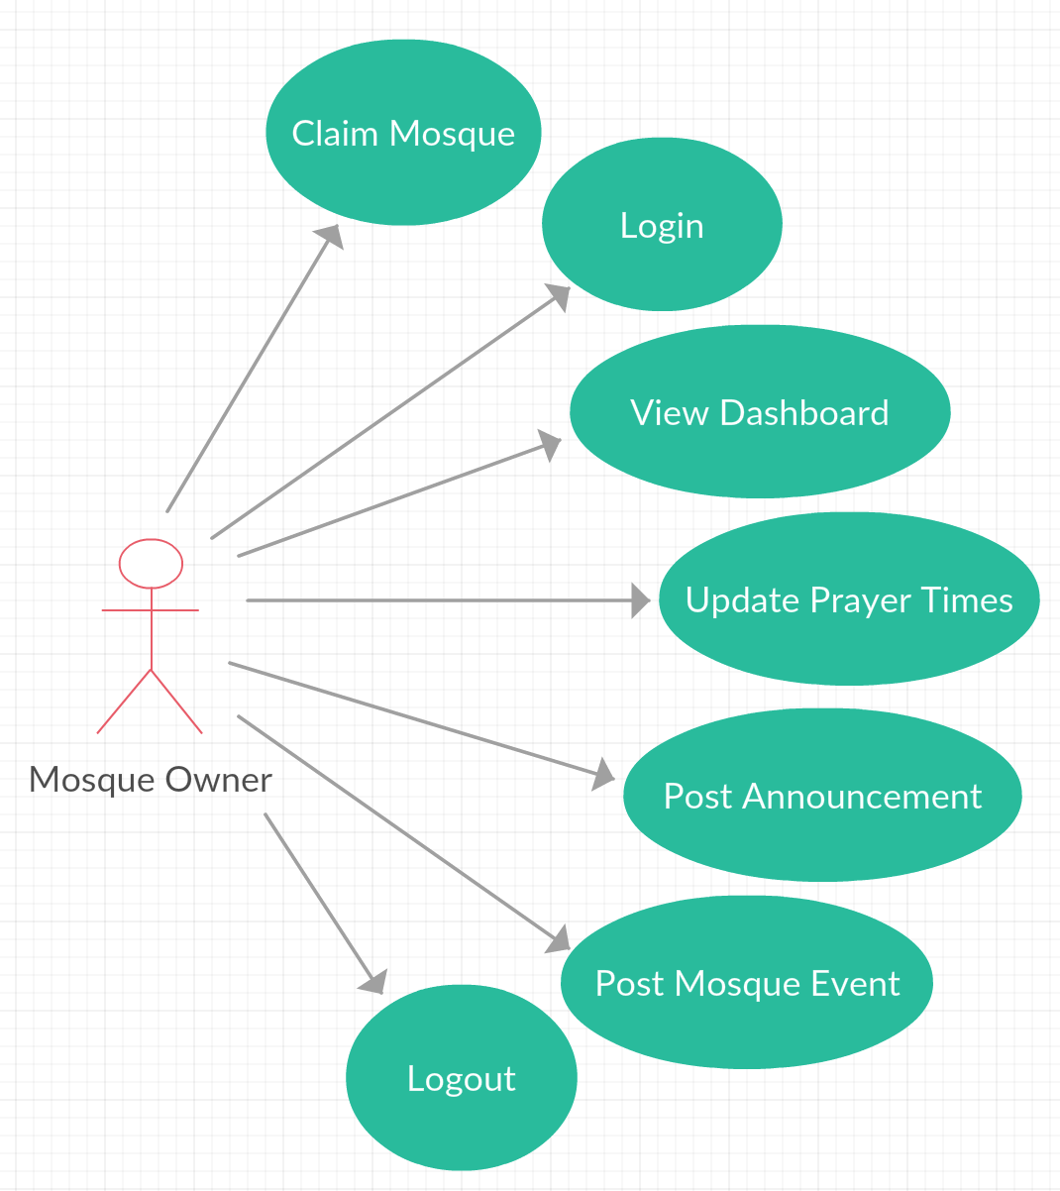

Slide 20
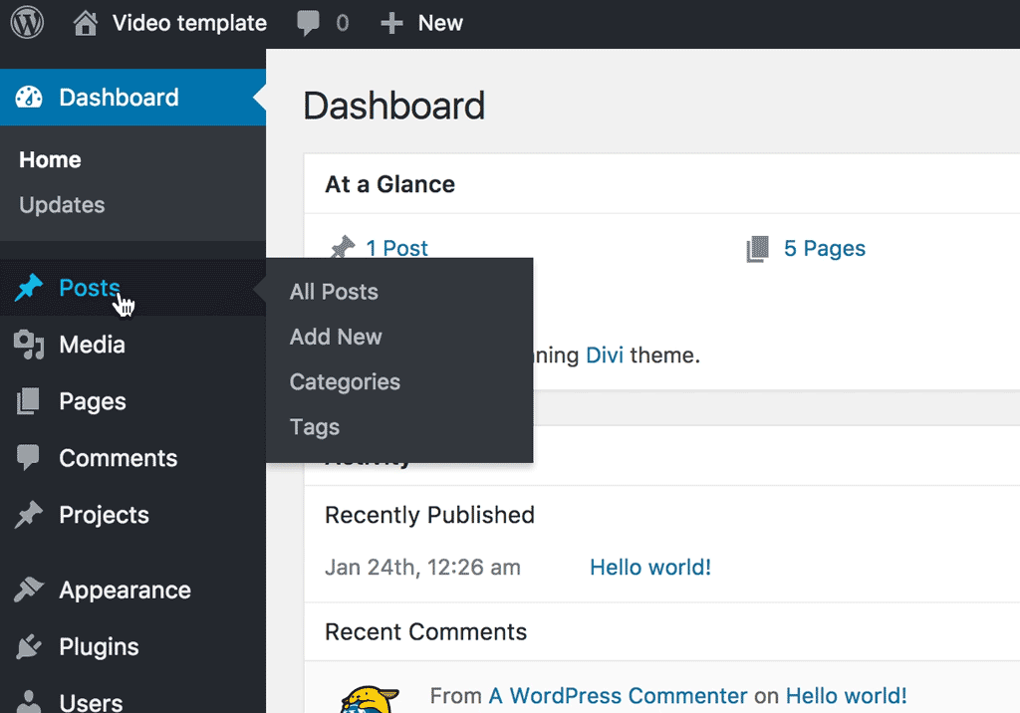
Notes:
and this is what the dashboard would look like. Instead of wordpress as in this picture, I will be using a bootstrap template.
Next let’s look at the regular user’s use cases

Slide 21
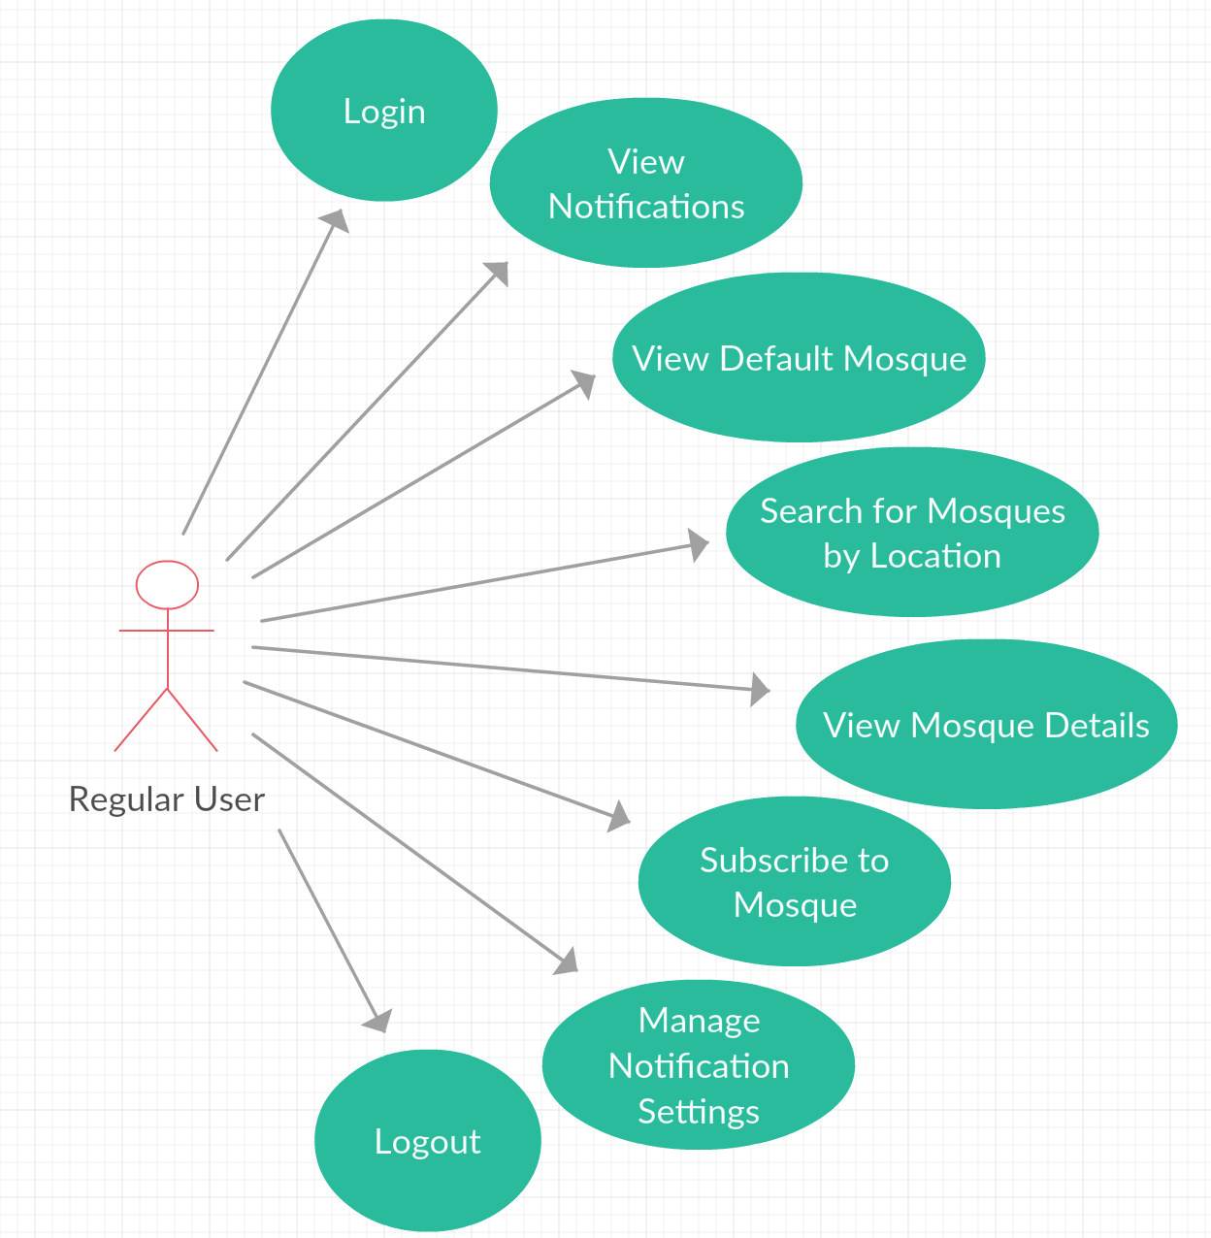

Slide 22
Application Design
Notes:
Now I’ll show you what I envision my app to look like in the end.

Slide 23
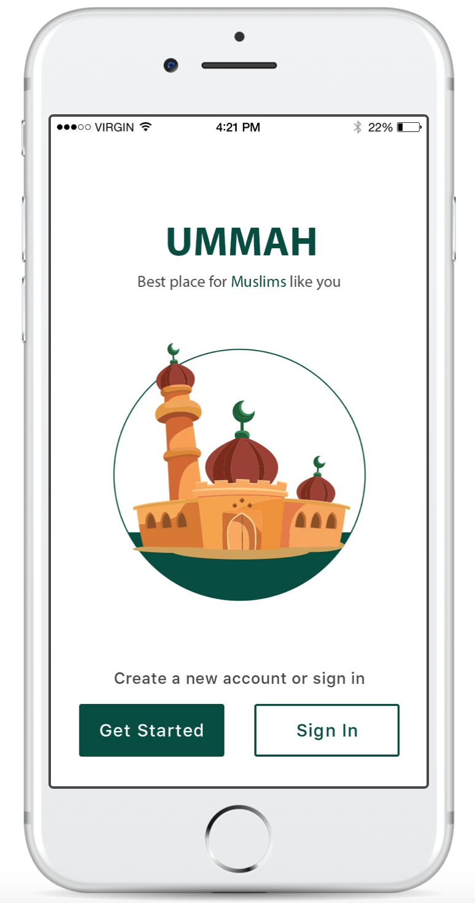
Notes:
Here’s the main screen - user can create an account or log-in here

Slide 24
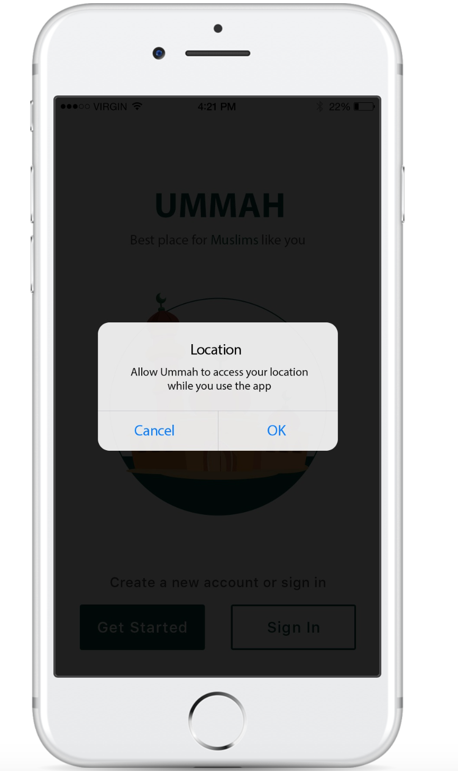
Notes:
After the user logs in, the app will request access to their location

Slide 25
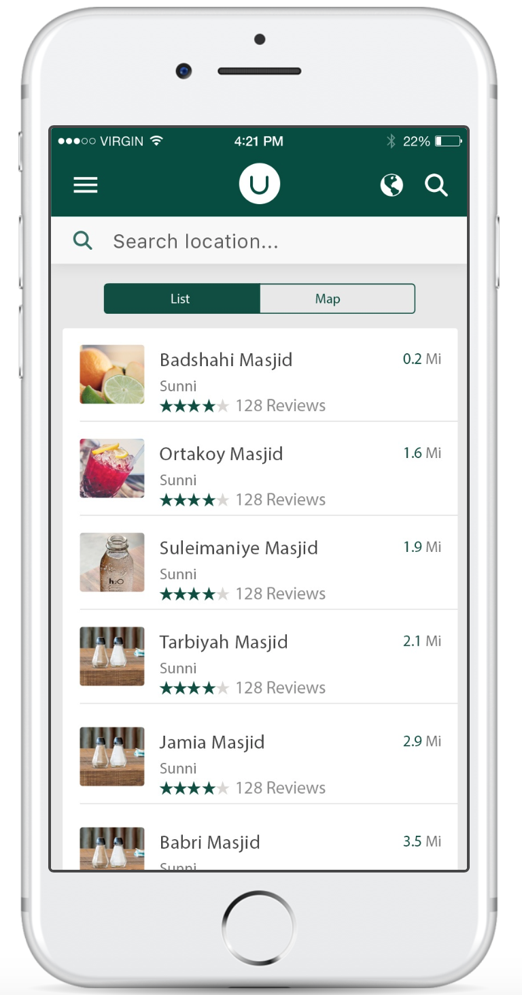
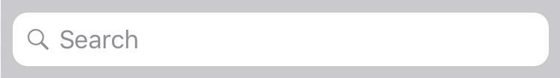
Enter city, state, or zip code
Notes:
If they deny, they will see a search bar so they can enter a specific location

Slide 26
Notes:
If they accept they will see this screen, which shows a list view of mosques in their area
The list view screen is my immediate focus for the prototype.

Slide 27
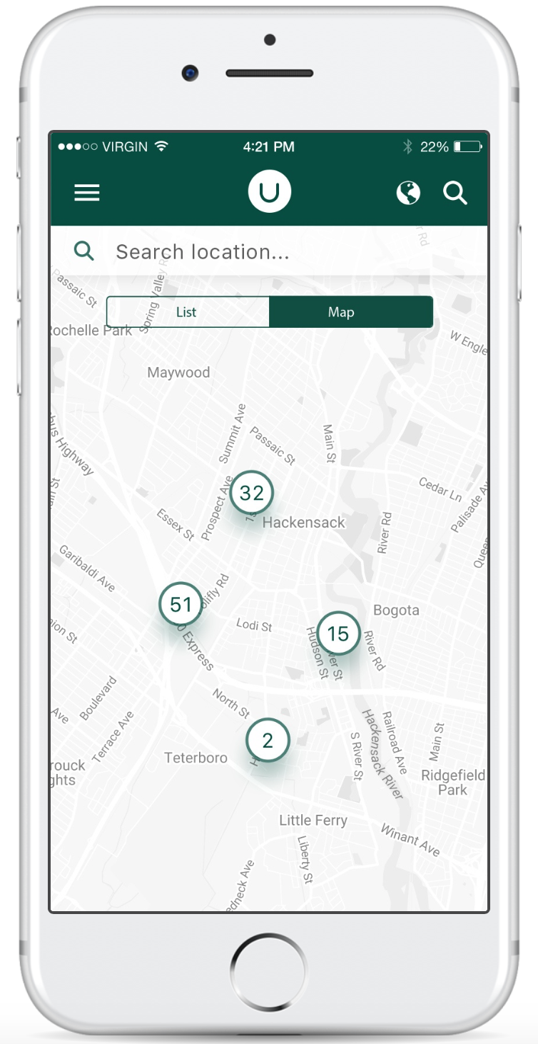
Notes:
I do however plan to develop a map view as well.

Slide 28
Notes:
So once user selects a mosque they will see a detail view of that mosque

Slide 29
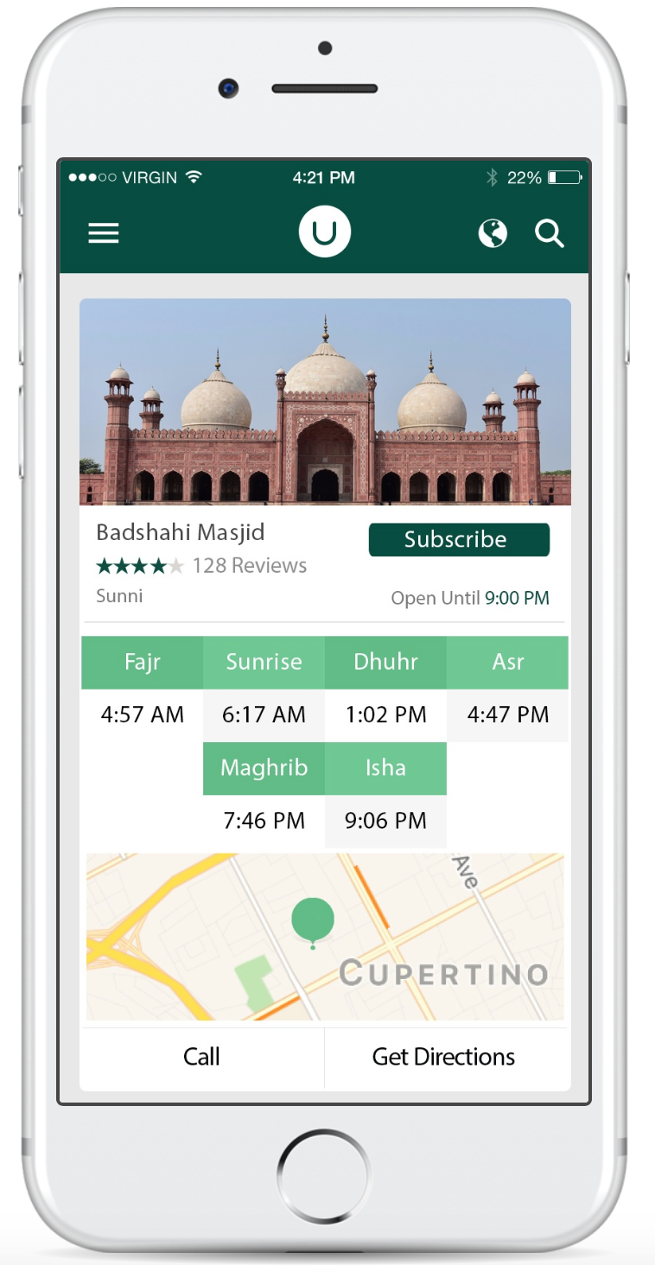
Notes:
Here they can see some more details such as the mosque prayer times, they can call the mosque, get directions, and …

Slide 30
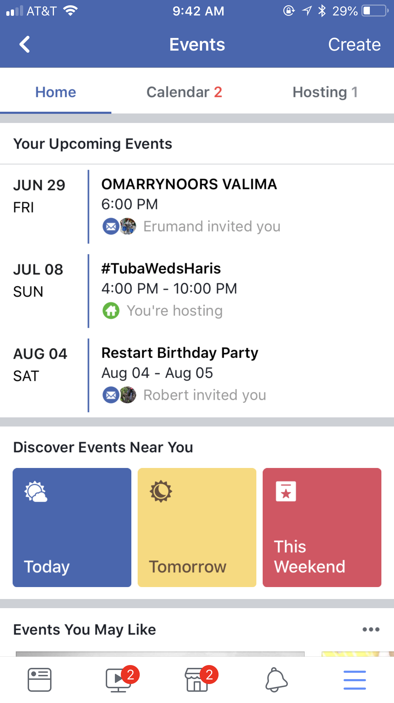
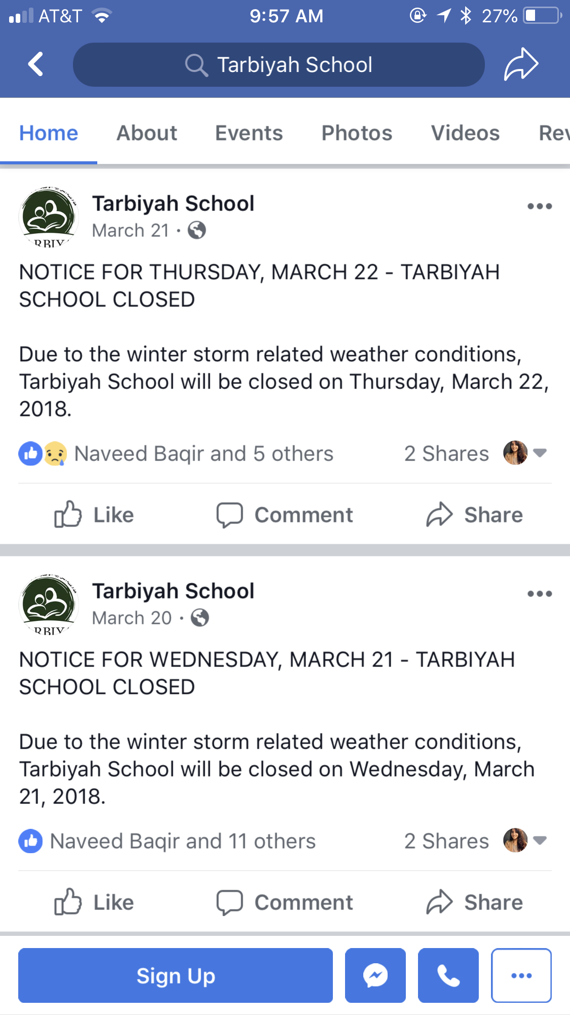
Events
Summer Bazaar & BBQ
Multiple Hosts
Community Health Fair
Hosted by Masjid
Announcements
Badshahi Masjid
NOTICE FOR THURSDAY, MARCH 22 - MASJID CLOSED
Notes:
They can even keep updated about all the upcoming events, along with any mosque announcements!

Slide 31
Events
Summer Bazaar & BBQ
Multiple Hosts
Community Health Fair
Hosted by Masjid
Announcements
Badshahi Masjid
NOTICE FOR THURSDAY, MARCH 22 - MASJID CLOSED
Notes:
and If the user really likes this mosque….
NEXT

Slide 32
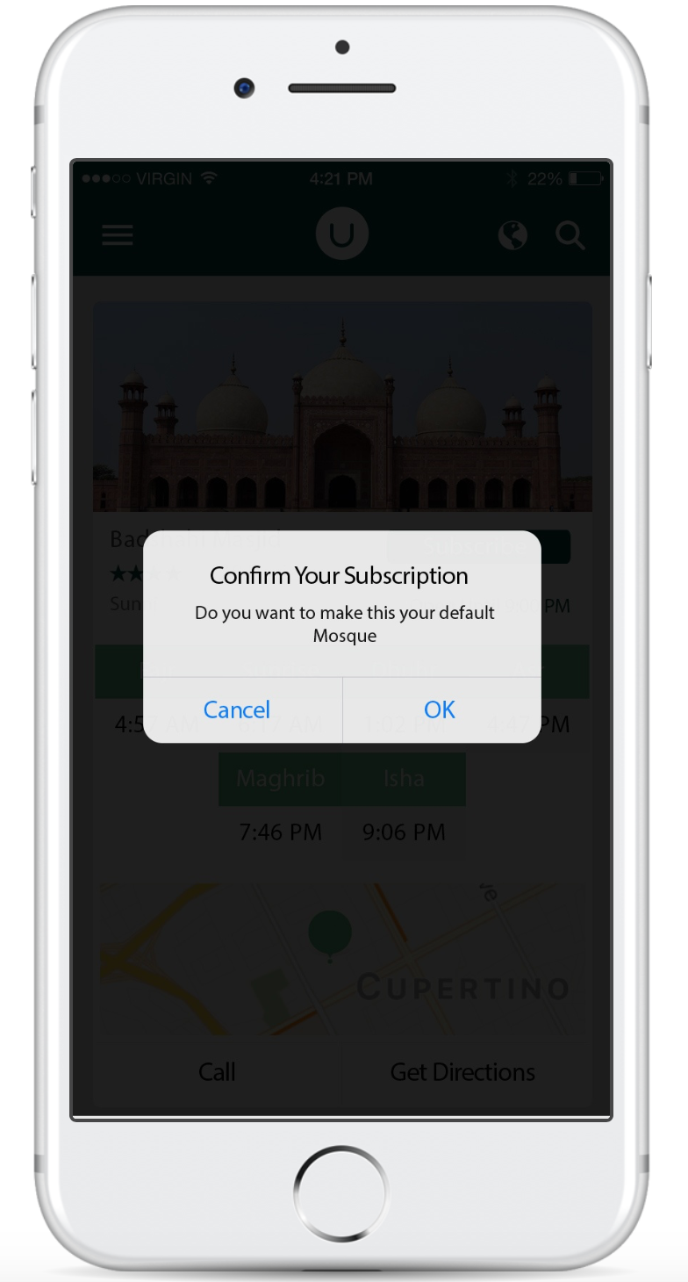
Notes:
They can subscribe to it and they will get any updates from the mosque right on their phone!
This might seem like a small feature, but it’s what differentiates my app from any other mosque app out there.
I’m eliminating the process of mosques reminding the community to check for updates via email, on their website, etc…

Slide 33
Goals
Notes:
Some of the goals I wanted to accomplish with my app are

Slide 34
Goals
Find Mosques easily
Notes:
1. To make it really easy for users to find mosques, whether in an unknown area, or around their town.

Slide 35
Goals
Find Mosques easily
Get connected to favorite Mosques
Notes:
2. Help the community keep up to date with their favorite mosques

Slide 36
Goals
Find Mosques easily
Get connected to favorite Mosques
Make Mosque owners’ life easier
Notes:
and Lastly, to make it really easy for Mosque owners to communicate with the users by developing a simple dashboard for all Mosque owners.

Slide 37
Ummah System

Slide 38
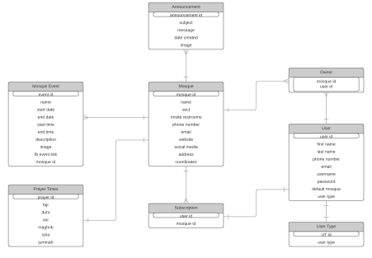
Notes:
The Ummah system is actually quite complex and I spent a lot of time on the actual structure of the database.
You can see here that the Mosque entity is a major piece as it’s in the center connecting all other entities.
PAUSE.
To bring this system to life, I am using…

Slide 39
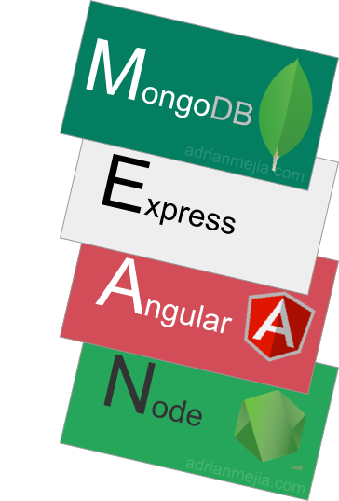
MEAN Stack
Notes:
the MEAN stack..however

Slide 40
MEAN Stack
Notes:
I swapped out mongoDB with

Slide 41
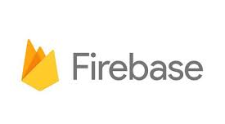
FEAN Stack
Notes:
firebase database.
let’s look at how these components are talking to each other…

Slide 42
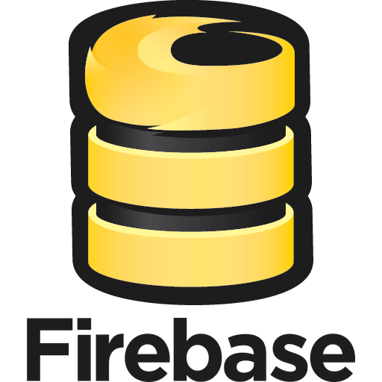
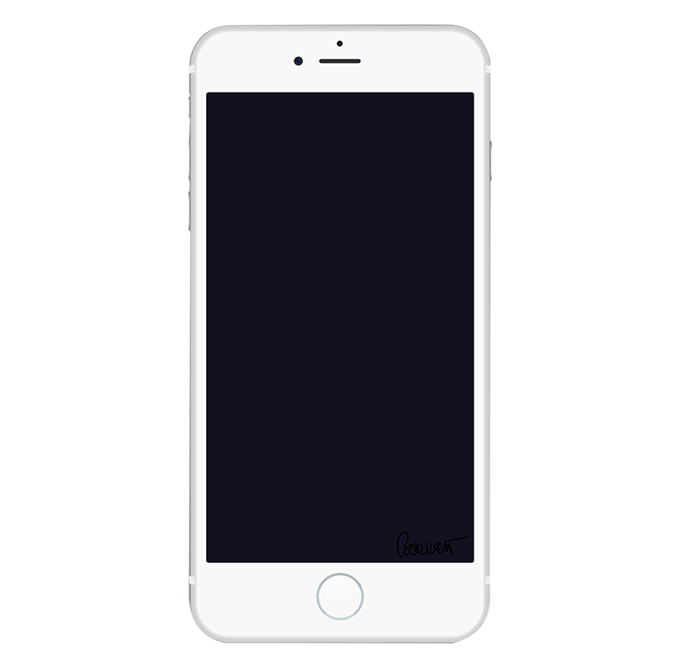
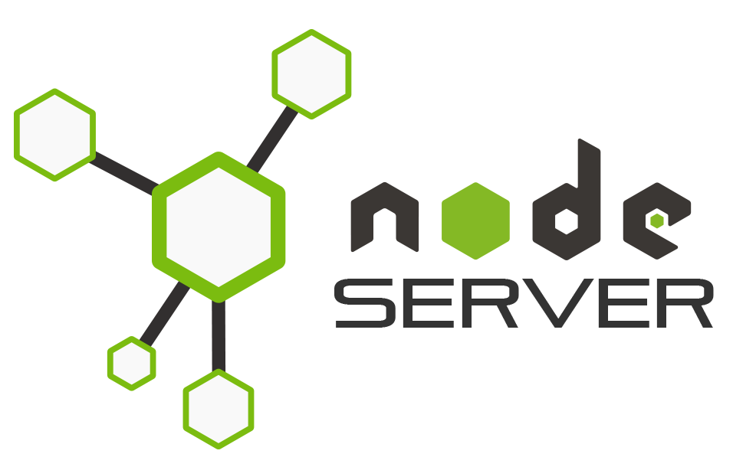
Notes:
NEXT

Slide 43
Notes:
First you have the Mosque owner dashboard where the mosque owners will claim their mosque. I will use a bootstrap template for this.
Any data the mosque owners posts..

Slide 44
Notes:
will be stored in the firebase database, this data will then be sent…

Slide 45
Notes:
to the node js server.
Then, the server sends this data to

Slide 46
Notes:
the app, while the user is using the app.
Now anytime the user opens the app…

Slide 47
✅
🙂
Notes:
they will always have the most updated data!

Slide 48
DEMO
Notes:
Now I’ll show you guys my implementation so far

Slide 49
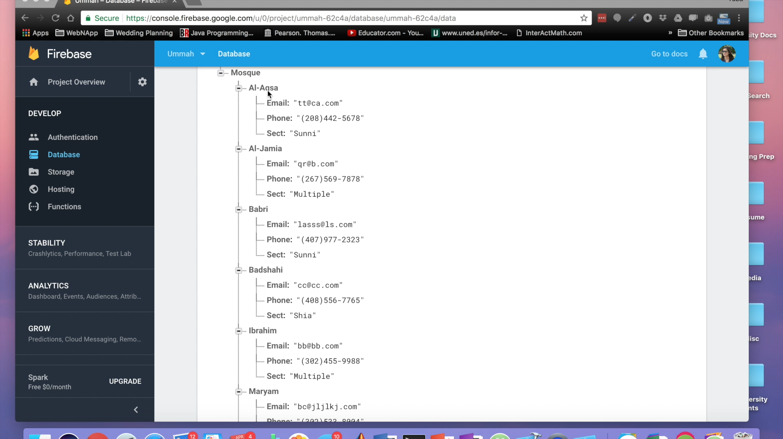
Notes:
Right now you are looking at the firebase data.
you can see all the mosque data in there
next, I start up the node.js server
and now I can run my app.
Once the app starts up, it asks for location permission - you can see that I have accepted.
After logging in I will see a list of mosques (which is supposed to be based on my current location)
this data is being pulled from the firebase database I showed earlier
Now I show what happens if the user does not give location permission
Basically, the user will come to a search screen where they will have to enter a location in order to see a list of mosques

Slide 50
DEMO

Slide 51
Future Work
Notes:
Aside from completing the rest of the app. I’ve thought about ways to expand as well

Slide 52

Future Work
Find Halal Restaurants/Stores
Develop similar model for churches, parks, schools, etc.
Notes:
One feature I want to add is
to allow users to find nearby halal restaurants or grocery stores

Slide 53
Future Work
Find Halal Restaurants/Stores
Develop similar model for churches, parks, schools, etc.
⬅️
Halal = Islamic Way Certified ✅
Notes:
Halal just means the food Islamic certified
PAUSE
This is a necessity bc

Slide 54
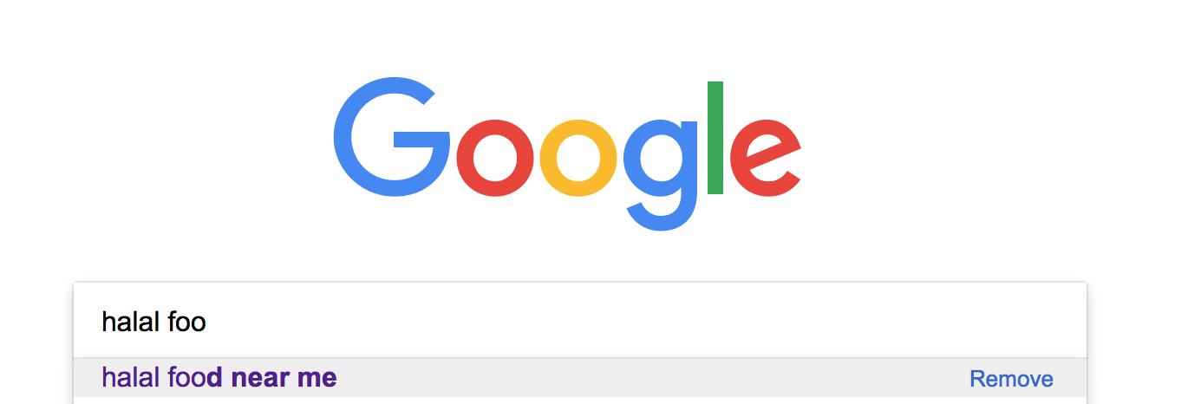
Halal Food Search
Notes:
When I do a search on google for halal food

Slide 55
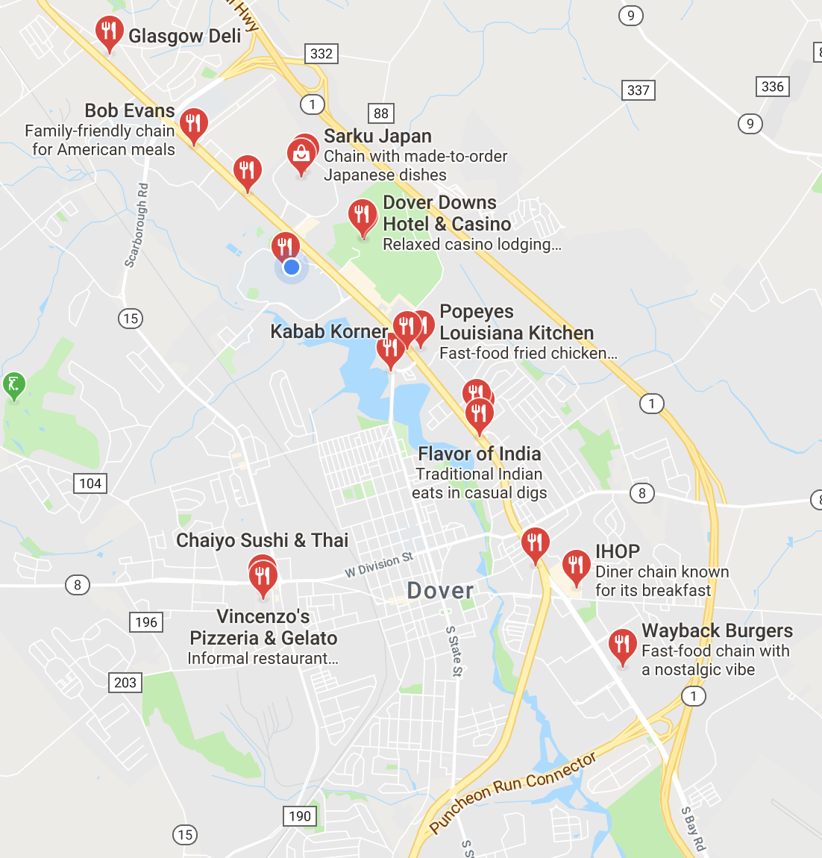
Halal Food Search
Dover
Notes:
I get these results… and if you look closely

Slide 56
🤦🏻‍♀️
Dover
Notes:
you’ll see that actually most of these are not halal restaurants at all.

Slide 57
Future Work
Find Halal Restaurants/Stores
Develop similar model for churches, parks, schools, etc.
⬅️
Notes:
Another idea I had was to….develop

Slide 58
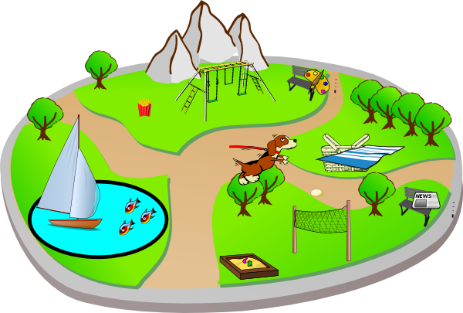

Future Work
Find Halal Restaurants/Stores
Develop similar model for churches, parks, schools, etc.
⬅️
Notes:
this “app as a service” model for more businesses such as churches, parks, schools…
CLICK!!
Imagine being always up-to-date about your local parks CLICK!! events…by just the click of a button!
PAUSE…….. PAUSE…….. PAUSE…….. PAUSE…….. PAUSE…….. PAUSE……..

Slide 59

Notes:
I want to thank Dr. Smolinski, CIS department faculty & students, and my family (sitting out in the audience) — you have all contributed to my success in one way or another and I’m so grateful to have been surrounded by brilliant people throughout my journey here.

Slide 60
Q/A

Slide 61
Statistics
According to Pew Research Center, approximately 24% of the countries in the world were “Muslim-Majority” countries in 2015.
76% Non-Muslim Majority countries
Notes:
According to a study done in 2015 ….24% of the countries were Muslim-Majority countries

Slide 62
Statistics
According to Pew Research Center, approximately 24% of the countries in the world were “Muslim-Majority” countries in 2015.
76% Non-Muslim Majority countries
⬅️
Notes:
Which means there are a lot more countries that have Muslim minorities.
I will explain why this is significant in a bit

Slide 63
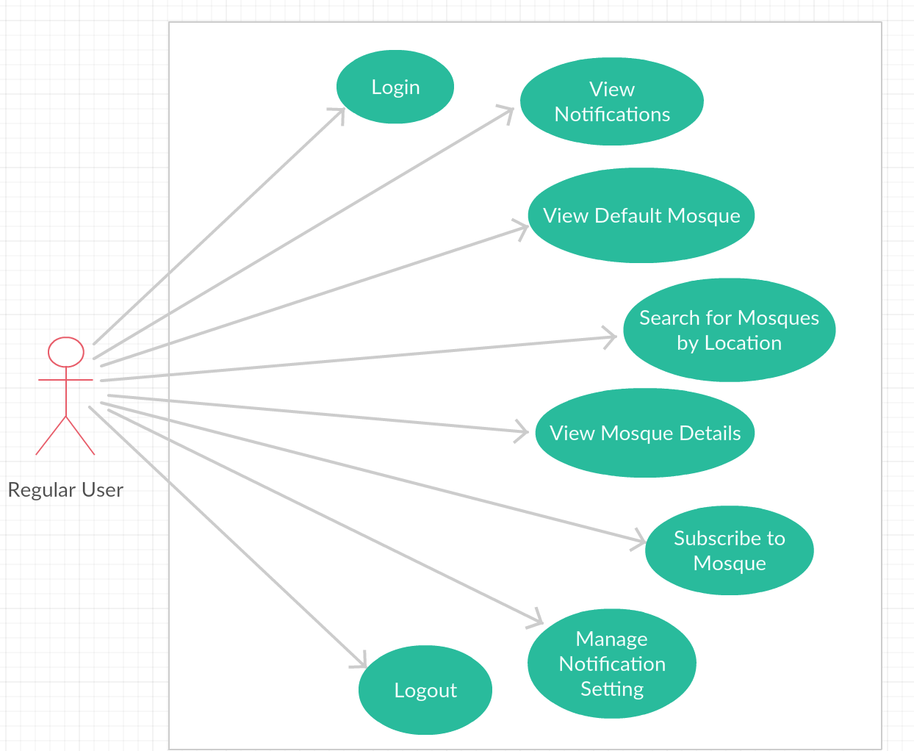
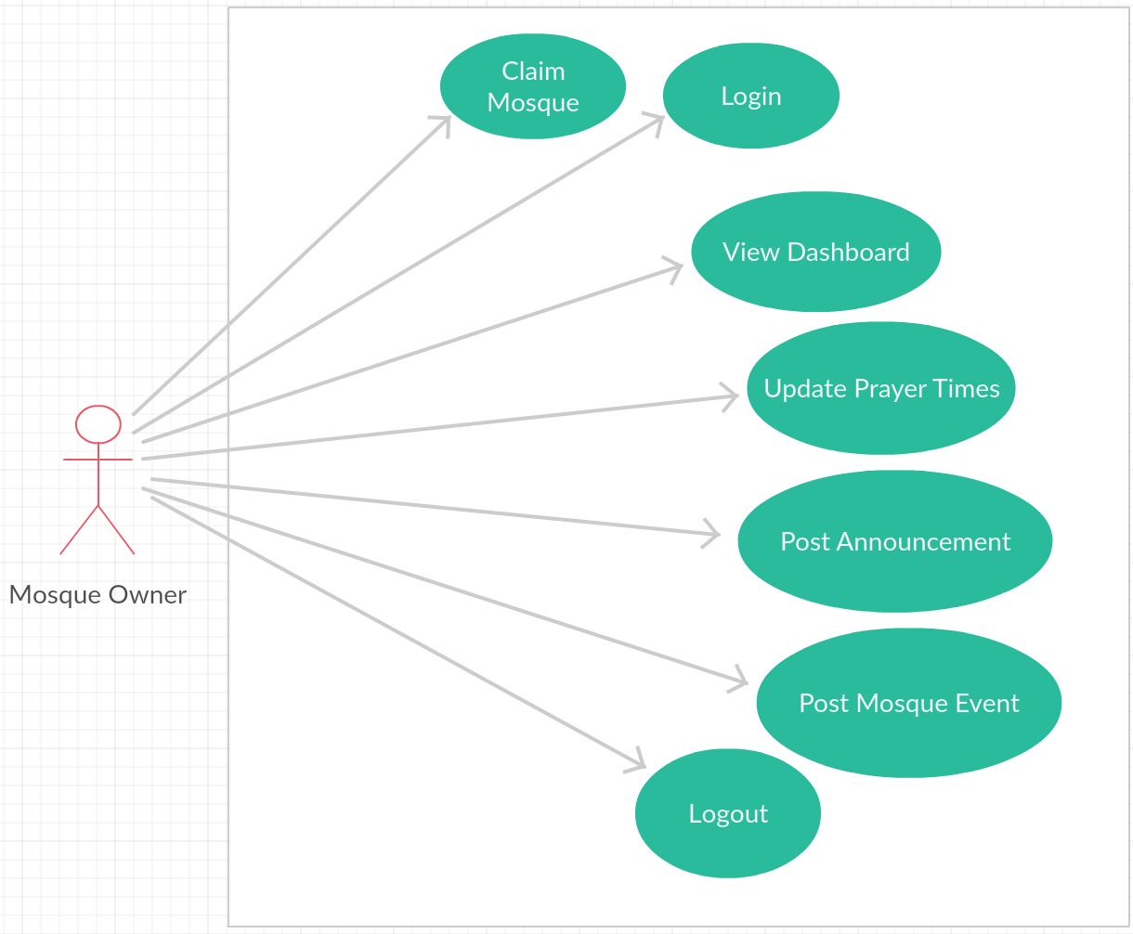
Use Cases
Notes:
Here are some actions both users will be able to perform.

